Slide 1
Building Trusted AI
Mandy Chessell, IBM

Slide 2
Building Trust
Trust comes from multiple factors, but essentially it comes down to:
Reliability in a digital service’s results, availability and performance.
Protection of their data and related intellectual property so it is not lost, used or stolen by unauthorised parties.
Transparency and openness in how the results are produced – and how the data entrusted to the service is used.

Slide 3

The ice cream seller
Could a digital service help her business?
How would she know it was giving accurate results?
She needs to understand the operation of the service.

Slide 4
Reasons a digital service gives bad results
The data that is fed into the service is just wrong.
For example, if the weather forecast used is not very accurate.
The situation that the digital service is being used for is not appropriate.
For example, an internal AI model was trained with data from Italy and the ice cream seller was using it for the UK. The AI model in this case could be inaccurate if the ice cream buying habits in Italy are different from those in the UK.
The model of the world it is using is too simplistic.
For example, the ice cream sales may also be affected by humidity, or whether it is the school holidays and this is not taken into account by the model.

Slide 5
Buyer beware …
Past
Present
Future
How was it developed?
How is it deployed?
How will it be maintained?

Slide 6
Sliding scale of risks
Data is being correlated from many sources
Data coming from single dedicated source
Fully automated decision
Supporting a human expert
Real-time decision
Off-line information, part of bigger process
Significant consequences for individuals
Limited impact on individuals
Decision reasoning is opaque
Decision reasoning is transparent

Slide 7
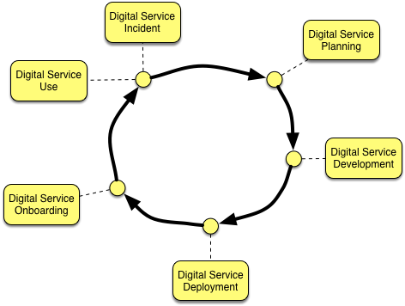
Trust is built at each stage in the digital service lifecycle
At each stage in the development of a digital service, choices are made that will determine the level risk inherent in the service.
Appropriate actions taken create trust that the consumers will ultimately have in the digital service and any AI embedded.

Slide 8
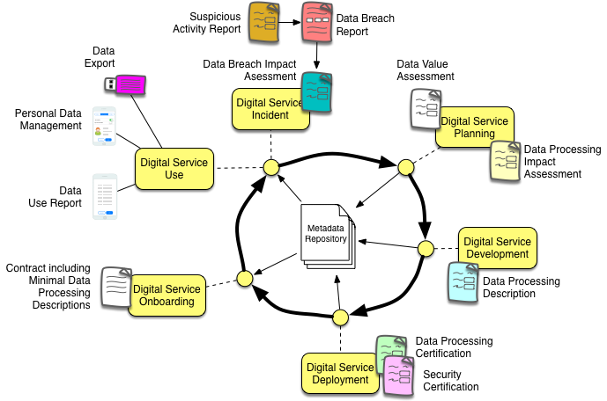
Trust is built at each stage in the digital service lifecycle
A metadata service retains and links knowledge of these decisions so that:
it is able to govern the digital service while it is operation
Key information is available to individuals

Slide 9
Open forum
z
z
z
z
z
z
z
Questions?

Slide 10
Links
Press Release and Podcast
Open source repositories
https://www.linuxfoundation.org/press-release/2018/08/odpi-announces-egeria-for-open-sharing-exchange-and-governance-of-metadata/
https://roaringelephant.org/2018/09/25/episode-107-open-metadata-and-governance-masterclass-with-mandy-chessell-part-1/
https://roaringelephant.org/2018/10/09/episode-109-open-metadata-and-governance-
masterclass-with-mandy-chessell-part-2/
https://github.com/odpi/data-governance
https://github.com/odpi/egeria

Slide 11
